Slide 1
FeedBack Control for your FIRST robot’s drivetrain
David Giandomenico
Team mentor for
Lynbrook Robotics – Team #846
<DGiandomenico@LynbrookRobotics.com>
Notes:
My intended audience is high school students involved actively in FIRST Robotics.
This talk covers basics of feedback control, together with discussions of practical techniques of measuring position and speed, dealing with changing loads, nonlinearities etc.

Slide 2
Driving Smart
Make your robot easy to drive
Using brakes
  More control when turning
Closed Loop (Feedback) control
  Precision driving

Slide 3
Turning without Brakes
When the joystick is at neutral position,
the robot coasts.
When turning, the inboard motor coasts,
gradually slowing, causing the robot to spiral!
If reverse power is applied during a turn,
the robot easily spins out.

Slide 4
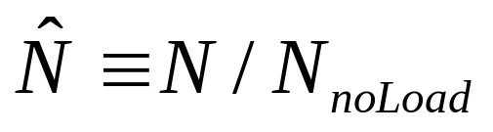
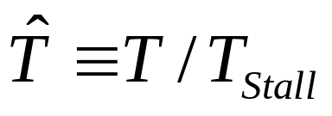
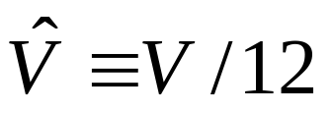
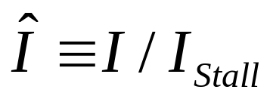
Normalized Quantities
  Speed
  Torque
  Voltage
  Current
The reference quantities must be measured on the Robot

Slide 5
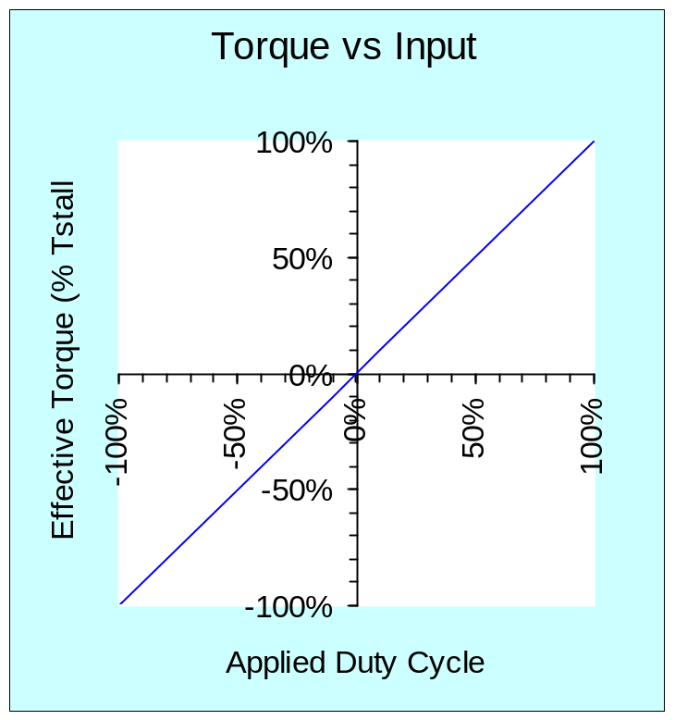
Ideal Torque vs Joystick (PWM)Input
Ideal case:
  Robot not moving
  no drag
  Jaguar (not IFI Victor884)
Notes:
Victor 884 has poor linearity compared to Jaguar due to low switching rate of120Hz vs 15,000 Hz.
At low freq., motor inductance is ineffective in smoothing the motor current.

Slide 6
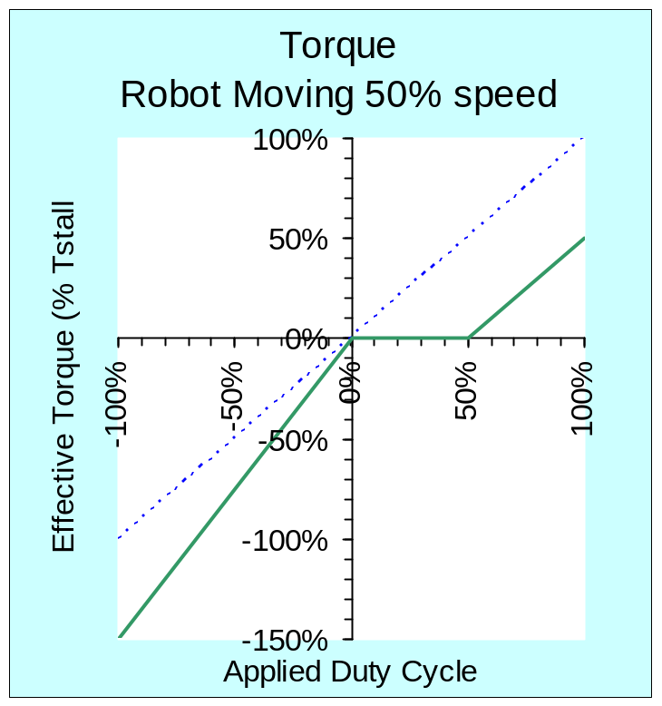
Robot is Non Linear when Moving
PWM Speed Controller can’t “sink” current.
“ESC” model
+
+12V
M
EMF < 12V
−
Robot coasts when input is less than robot speed!
Notes:
Very simple model of ESC. A better model would be a buck type switching supply.
Again, this pertains to Jaguar ESC. Victor884 behaves a bit differently.

Slide 7
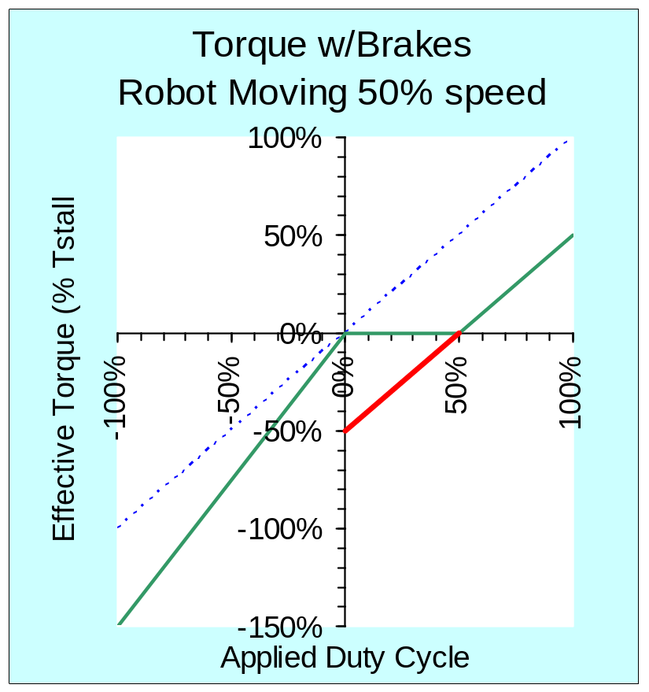
Use Brakes to Fix the Curves
The Fix:
Measure the robot speed.
Calculate:
(Robot_Speed – Joystick_Input)
Apply brakes proportional to this amount.
Notes:
Very simple model of ESC. A better model would be a buck type switching supply.
Again, this pertains to Jaguar ESC. Victor884 behaves a bit differently.

Slide 8
Dynamic Braking
+
Rotation generates voltage
Short allows current flow
Current creates magnetic field that resists rotation
−
Notes:
Mechanical rotation of the motor generates voltage
Induces current
Where does energy go? (Dynamic braking is not Regenerative Braking)

Slide 9
H-Bridge: Inside your Motor Controllers
H
12 V
S-1
S-2
S-3
S-4
+
−

Slide 10
H-Bridge:
Inside the IFI SPIKE Relay Module
12 V
½ Tyco 2VR-1001
½ Tyco 2VR-1001
Fwd Relay
Rev Relay
+
−
M+
M
M−
INPUTS |  | OUTPUTS |  | MOTOR FUNCTION
Fwd | Rev | M + | M –
0 | 0 | GND | GND | Off (Braked)
0 | 1 | GND | 12V | Reverse
1 | 0 | 12V | GND | Forward
1 | 1 | 12V | 12V | Off (Braked)
Motor is “Braked”
Even when unpowered!
Notes:
Supplementary slide; Spike Relay Module contains two SPDT* Relays
*Single Pole Double Throw

Slide 11
Dither Braking
1 2 3 4 5 6 7
8 9 0 …
Packet or loop_count
const int brakebit[8][7]= {
{0,0,0,0,0,0,0},
{1,0,0,0,0,0,0},
{1,0,0,1,0,0,0},
. . . };
int dither =
brakebit[ brake_amt ][ packet % 7];
ApplyBrake( dither );

Slide 12
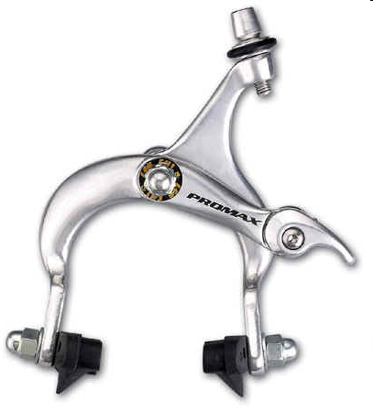
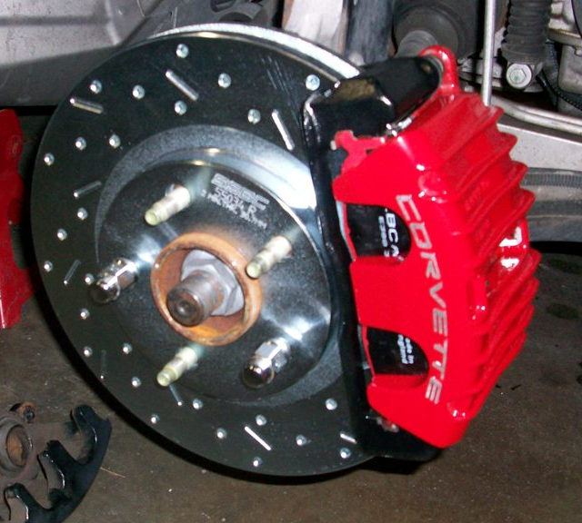
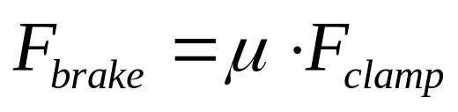
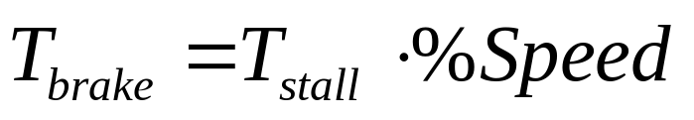
Dynamic Braking Increases with Speed
Common “caliper brake” applies constant drag.
Dynamic brakes apply drag proportional to speed.
Bike brake
Car brake
Notes:
Where does this formula come from?

Slide 13
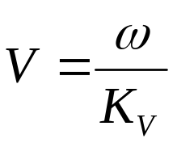
Dynamic Braking
+
M
+
−
−
Rotation generates voltage proportional to speed
Short allows current flow, I = V/R
Creates magnetic field that resists rotation, T = K_{t} I
Notes:
Mechanical rotation of the motor generates voltage
Induces current
Where does energy go? (Dynamic braking is not Regenerative Braking)

Slide 14
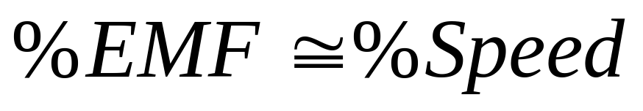
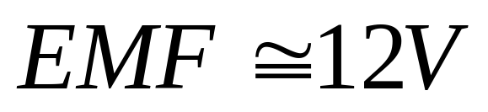
Faster → Brakes Harder
Motor voltage:
With no load, and 12V applied,
When shorted at full speed, Motor delivers most of I_{stall}, and develops T_{stall}

Slide 15
Quick Observations
At 100% speed, when the motor is shorted, the motor resists with about 100% of its stall torque.
At 40% speed, we get ~40% of the stall torque.
How can we deliver
a known amount of braking?

Slide 16
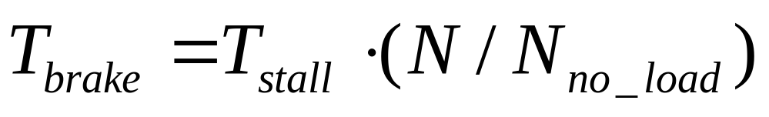
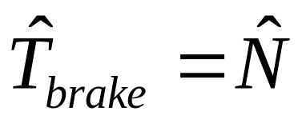
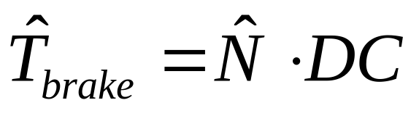

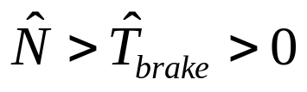
Calculate duty cycle, DC, to apply the brakes.
When shorted, and the motor is running at speed N,
Or, with normalized quantities, when the motor is shorted,
To achieve a normalized braking torque, T,
Pulse brakes with a duty cycle, DC:
Notes:
Normalized quantities on {0,100%}

Slide 17
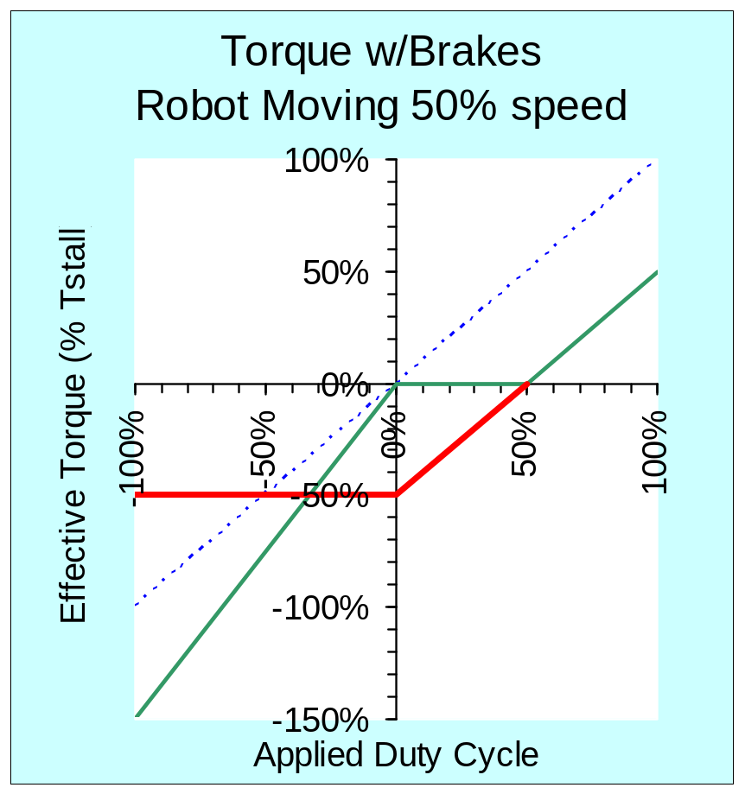
Adjusting Brakes for Speed
The Fix:
Measure the robot speed.
Calculate:
B = (Robot_Speed – Joystick_Input)
To brake at rate ‘B”, calculate Duty Cycle:
  if (N>B>0) then DC = B/N;
  else DC = 100%;
Notes:
Max braking is equal to the robot’s current speed, which in this case is 50%.

Slide 18
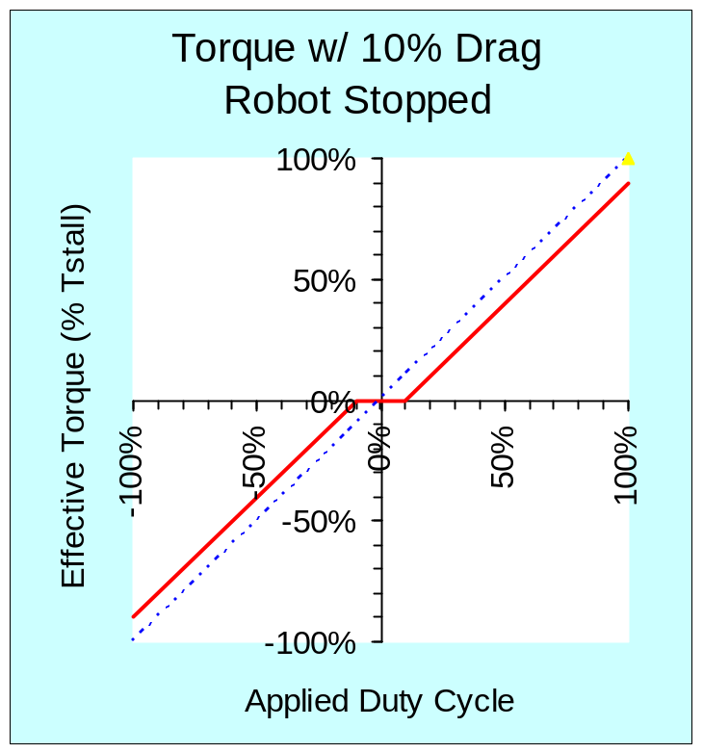
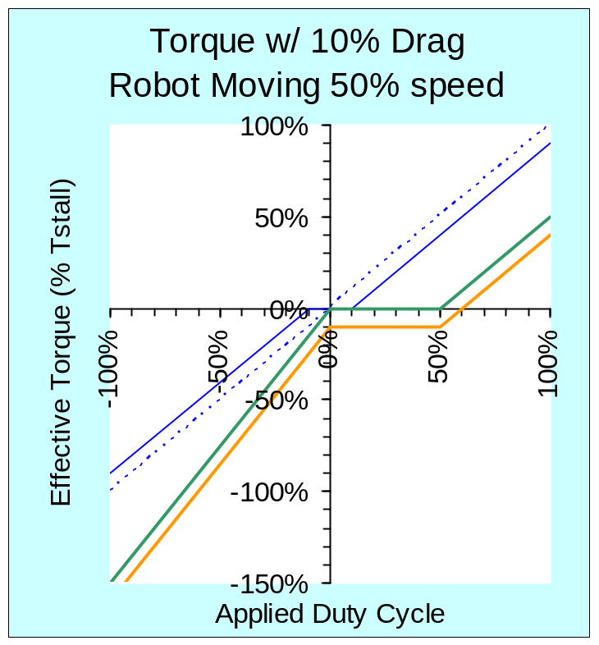
Effects of Friction
Friction adds braking
Requires tweaking the Brake algorithm
Notes:
Left as an exercise ☺

Slide 19
Benefits of Dynamic Braking
Turn without spinning out
Come to a straight dead stop
Linearized response for your
FeedBack Control Systems

Slide 20
Closed Loop Control for your FIRST robot’s drivetrain
What is Closed Loop Control?
Pros & Cons – Open Loop vs Closed Loop
Basic Velocity Control – demo & C++ code
Tuning the parameters

Slide 21
Control Systems
Open Loop System
Input
Controller
System
Output
Closed Loop System
Input
+
Measured
error
Output
Controller
System
n
−
Sensor
Measured output
Notes:
Examples: Open Loop: Light Dimmer
Closed Loop: Thermostat

Slide 22
Open Loop
Closed Loop
Pros
  + Simple
    Reliable
  + Fast to build
    More time to practice
Cons
  Harder to drive
  Less Capable
Pros
  + Precision maneuvering
  + Easier to drive
  + The Future
Cons
  More parts
  Less reliable
  More time to build
Notes:
So why closed loop?

Slide 23
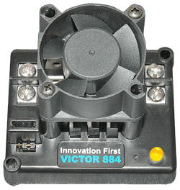
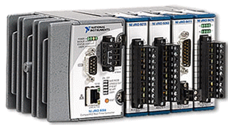
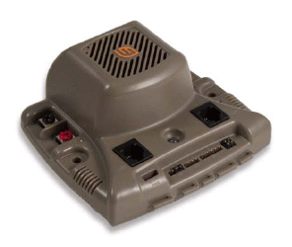

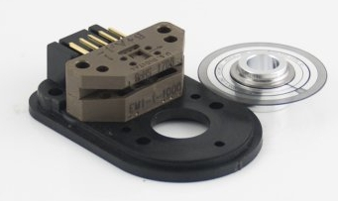
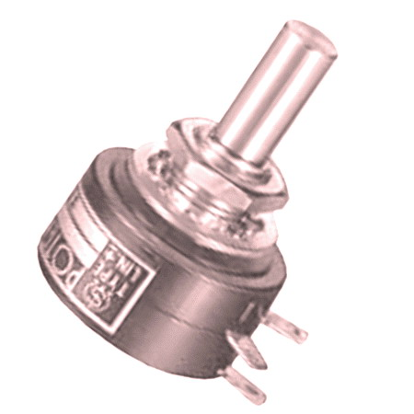
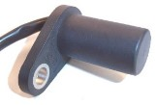
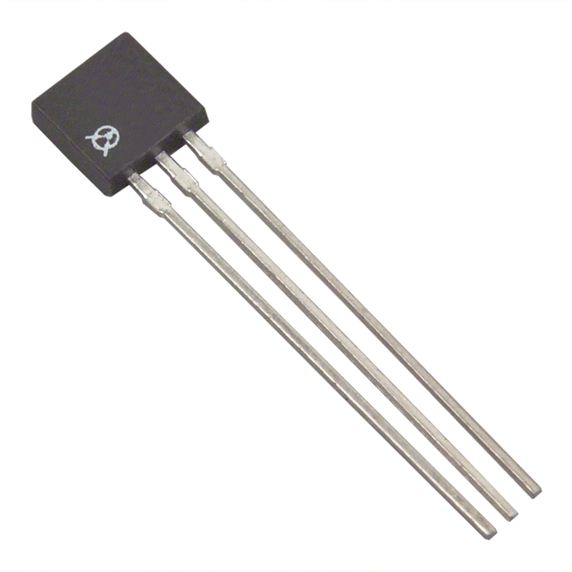
Closed-Loop Control System
Input Speed
or Position
(joystick,
preset button,
autonomous, etc.)
+
+
G
Out
E.S.C.
M
−
−
Sensor
Potentiometer, Encoder,
Gear Tooth Sensor,
Hall effect Sensor, …
Yet more sensors:
  Accelerometers & Gyros
  Optical Distance Meas.
  Cameras,
  Ultrasonic
  :
Notes:
Optical encoders, Hall effect (magnetic) sensors, Gear tooth sensors, potentiometers, gyros, …
Good for Position, but not for Velocity, because E.S.C. requires large signal input.

Slide 24
Speed Controller
cRio
+
+
ESC
M
Output
(speed)
Input
n
+
−
G
Measured
error
n
Speed Sensor
(Encoder)
+
−
Measured
output

Slide 25
Code Implementation: Forward Motion
DriveOutput
ClosedLoopDriveTrain::ComputeArcadeDrive(float rawFwd, float rawTurnRateRPS)
{
:
: Code for turning robot was here
:
float robotSpeed = m_encoders.GetNormalizedForwardSpeed();
float fwdError = rawFwd - robotSpeed;
float fwdCorrection = fwdError * m_pGainFwd;
float newFwd = rawFwd + fwdCorrection;
return m_dbsDrive.ComputeArcadeDrive(newFwd, newTurn);
}
cRio
+
Output
(speed)
Input
n
ESC
M
+
+
−
G
Measured
error
Measured
output
+
n
−
Speed Sensor
(Encoder)

Slide 26
Code Implementation: Turn at Rate
DriveOutput
ClosedLoopDriveTrain::ComputeArcadeDrive(float rawFwd, float rawTurnRateRPS)
{
float turningRate = m_encoders.GetNormalizedTurningSpeed();
float turningError = rawTurnRateRPS - turningRate;
float turningCorrection = turningError * m_pGainTurn;
float newTurn = rawTurnRateRPS + turningCorrection;
:
: Code for driving robot straight was here
:
return m_dbsDrive.ComputeArcadeDrive( newFwd, newTurn );
}
How do we set the gain, m_pGainTurn ?

Slide 27
Calibration and Tuning
Calibrate: Normalize your Robot’s Speed
  Measure no load speed on test stand
  Measure fastest rate robot can turn on floor
Tune the Gains
  Increase gain with robot on floor until oscillations start.
  Back-off gain.
TIP: Use a fast adjustment method, such as:
a potentiometer,
FTP to a data file on the cRio,
or, a driver-station control.
Notes:
Use these parameters in GetNormalizedSpeed() and GetNormalizedTurnRate()
DEMO Here: show the tuning process.

Slide 28
Feedback System
“Closed Loop”
In
+
G
Out
−
H

Slide 29


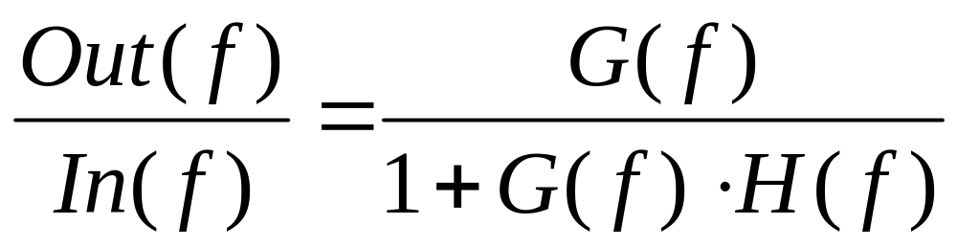
Feedback System
“Closed Loop”
In(f)
+
G
Out(f)
−
H

Slide 30
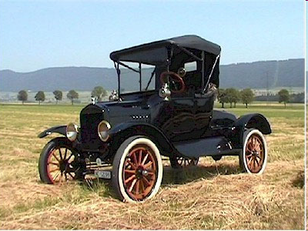
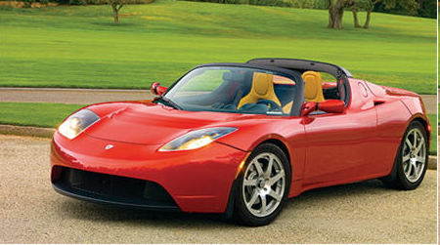
Moving Forward…
Where we started:
Basic Functionality
Where we are going:
Performance!

Slide 31
FeedBack Control for your FIRST robot’s drivetrain
David Giandomenico
Team mentor for
Lynbrook Robotics – Team #846
<DGiandomenico@LynbrookRobotics.com>
Notes:
My intended audience is high school students involved actively in FIRST Robotics.
This talk covers basics of feedback control, together with discussions of practical techniques of measuring position and speed, dealing with changing loads, nonlinearities etc.

Slide 32
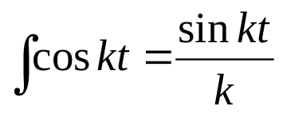
Robot Shakes: Filter the Error
DriveOutput ClosedLoopDriveTrain::ComputeArcadeDrive(float rawFwd, float rawTurnRateRPS)
{
float turningRate = m_encoders.GetNormalizedTurningSpeed();
// update the running sum with the error
float turningError = rawTurnRateRPS - turningRate;
turningError = m_turnRunningError.UpdateSum( turningError );
float turningCorrection = turningError * m_pGainTurn;
float newTurn = rawTurnRateRPS + turningCorrection;
:
: Code for driving robot straight was here
:
return m_dbsDrive.ComputeArcadeDrive( newFwd, newTurn );
}
Concept of integrating error:
Faster changing errors are not weighted as heavily as slow changing errors.
Consider:
Notes:
Supplementary – Time permitting.

Slide 33
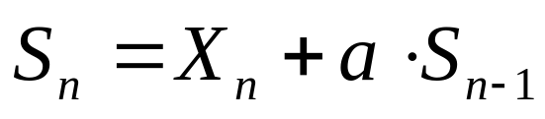
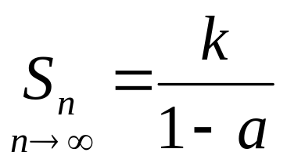
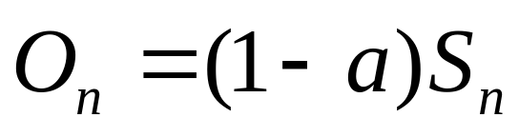
One Method: Running Sum Filter
Running sum, S_{n} with a decay constant, a
S_{n} converges to:
So, to prevent modifying our loop gain, return a scaled output, O_{n}
Examples:
1a + ½a + ½² a +½³ a + … + ½^{n} a = 2a
1 + ¾²+ ¾³ + … + ¾^{n} = 4
Notes:
Infinite Response Filter: Output depends on past outputs, so that response to a single input results in an infinitely long output sequence.
Many schemes are possible, and some may be better. This one is easy to implement.

Slide 34
Code Implementation: Integrate Error
Example Call:
turningError = m_turnRunningError.UpdateSum(turningError);
--------------------------------------------
class RunningSum {
:
: constructor was here
:
public:
float UpdateSum(float x) {
m_runningSum *= m_decayConstant;
m_runningSum += x;
return m_runningSum * (1 - m_decayConstant);
}
private:
float m_decayConstant;
float m_runningSum;
};
Notes:
Follow with demo of robot.

Slide 35
FeedBack Control for your FIRST robot’s drivetrain
David Giandomenico
Team mentor for
Lynbrook Robotics – Team #846
<DGiandomenico@LynbrookRobotics.com>
Notes:
My intended audience is high school students involved actively in FIRST Robotics.
This talk covers basics of feedback control, together with discussions of practical techniques of measuring position and speed, dealing with changing loads, nonlinearities etc.

Slide 36
Jaguar CAN; limited by serial port
Jaguar CAN bus 1Mbs
125KB/s, or 1.2KB every 1/100 sec
Serial Port: 56KBaud
= ~ 5.6KB/sec
or 56 bytes in 1/100 sec

